Slide 1
Warehouse Management System (WMS)
Prepared by,
21BCE314_Shrut Vanpariya
21BCE320_Khushi Vasavani
21BCE321_Yagnik Vasoya
OOP Project

Slide 2
WMS :
A warehouse management system (WMS) consists of software and processes that allow organizations to control and administer warehouse operations from the time goods or materials enter a warehouse until they move out.
What does a WMS do?
Warehouses sit at the center of manufacturing and supply chain operations because they hold all of the material used or produced in those processes, from raw materials to finished goods.
The purpose of a WMS is to help ensure that goods and materials move through warehouses in the most efficient and cost-effective way.
A WMS handles many functions that enable these movements, including inventory tracking, picking, receiving and putaway.
A WMS also provides visibility into an organization's inventory at any time and location, whether in a facility or in transit.

Slide 3
WMS :
Where WMS fits in the supply chain?
The supply chain can operate only as quickly, accurately and efficiently as warehouse processes permit. A WMS plays a vital role in supply chain management by managing order fulfillment processes, from receiving raw materials to shipping finished goods.
For example, if raw materials are not received properly or parts are misplaced in a warehouse, the supply chain may be slowed or disrupted. WMSes are critical in ensuring that these processes work smoothly by tracking inventory and making sure that goods are stored and sorted properly, as well as shipped and tracked accurately.

Slide 4
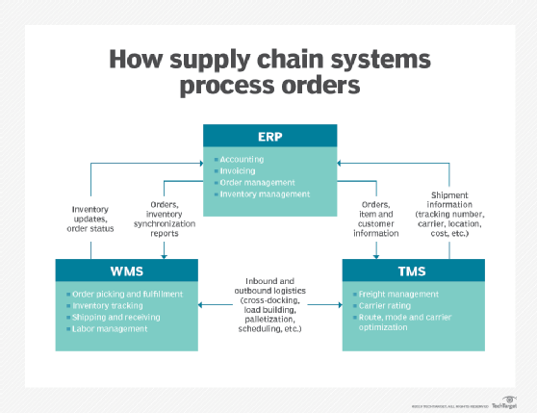
WMS :

Slide 5
Our project :
We have implemented warehouse management system(WMS) using java.
We have used object oriented concepts of java.
We have used classes, constructor, inheritance, file handling, exception handling.
We have implemented different methods for different purposes.
Features :
Add items in inventory
Search item in inventory
Delete item from inventory
View whole inventory
Shop

Slide 6
1. Add item in inventory
This method ask user to enter item details like item_code, item_name, item_rate and Item_quantity.
We store this item details in our inventory list.
If already item exist in our inventory list then we only update quantity.

Slide 7
2.Search item in inventory
We can search item by it’s name, code and rate.
So we ask the user for valid input.
This method traverse all item_list and check each item.
If item found in list then we will show it.
Else we will display “item not found”.

Slide 8
3.Delete item from inventory
We are providing the functionality to the user to delete any item from the inventory.
We can delete an item by it’s name and code.
So we traverse the item_list if entered item is found then we will delete it from inventory.
If such item is not found then we will display appropriate message.

Slide 9
4.View whole inventory
So we have provided the functionality that will allow user to see all items available in the inventory.
Basically we will traverse through item_list and print all data of inventory.

Slide 10
5.Shop
Shop contains features like purchase item, view cart and generate bill.
So purchase method will allow user to buy item from inventory and add items into cart.
View cart will display cart.
Generate_bill method will generate final bill of cart and bill contains total amount and details of customer.

Slide 11
Thank You

